Slide 2


Ansible
B
Y
K
U
M
A
R
B
Y
K
U
M
A
R

Slide 3
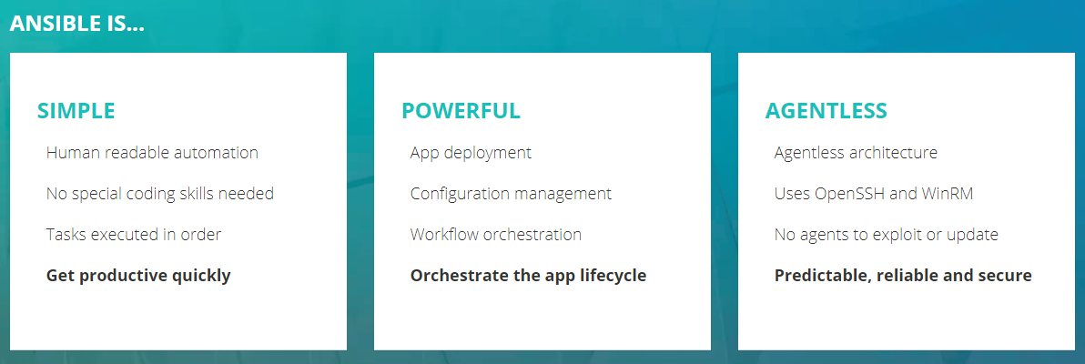
What is Ansible?
Ansible is designed around the way people work and the way people work together.

Slide 4
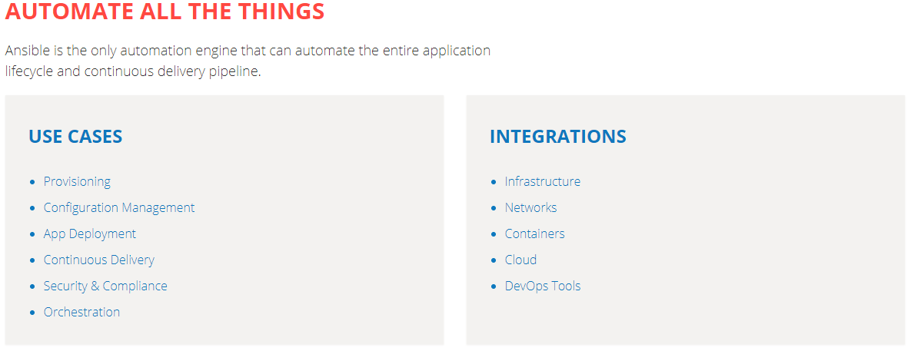
What is Ansible?

Slide 5
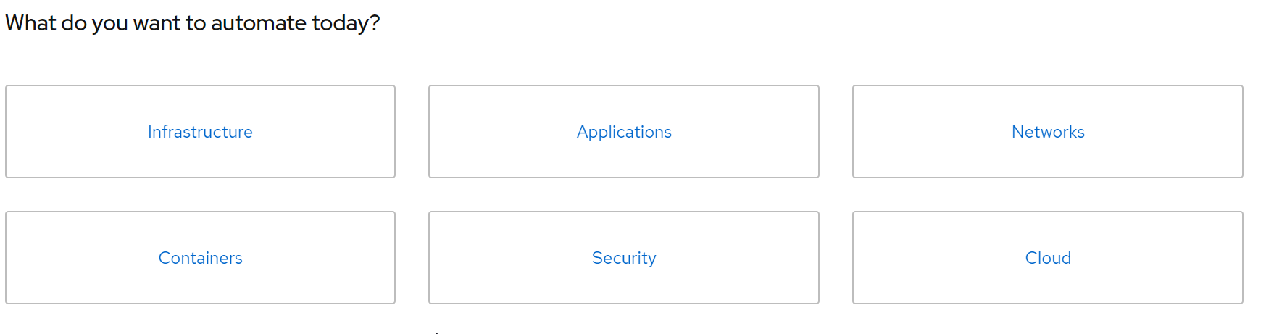
Why Ansible?
Working in IT, you're likely doing the same tasks over and over. What if you could solve problems once and then automate your solutions going forward? Ansible is here to help.

Slide 6
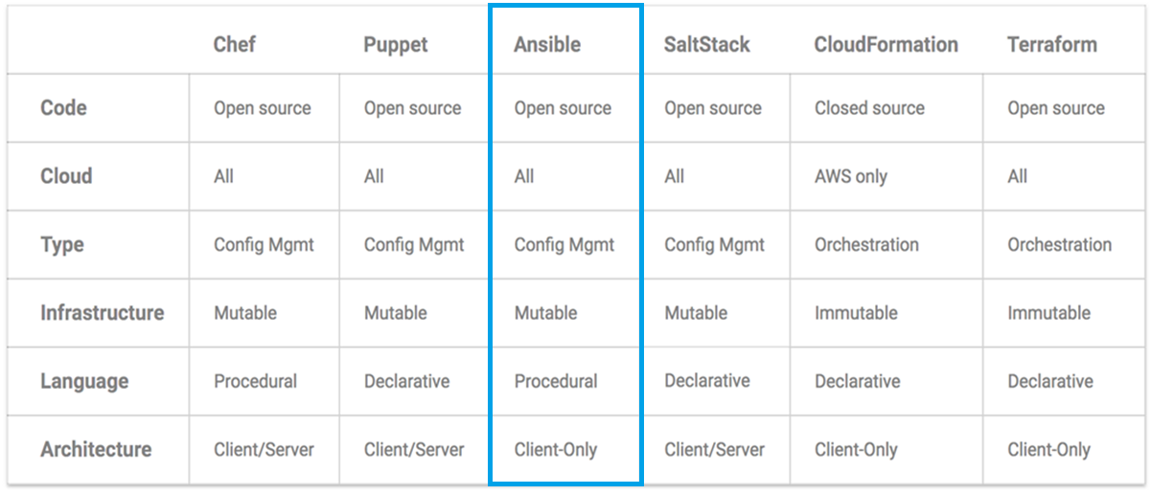
Ansible Vs Others
Notes:
https://blog.gruntwork.io/why-we-use-terraform-and-not-chef-puppet-ansible-saltstack-or-cloudformation-7989dad2865c

Slide 7
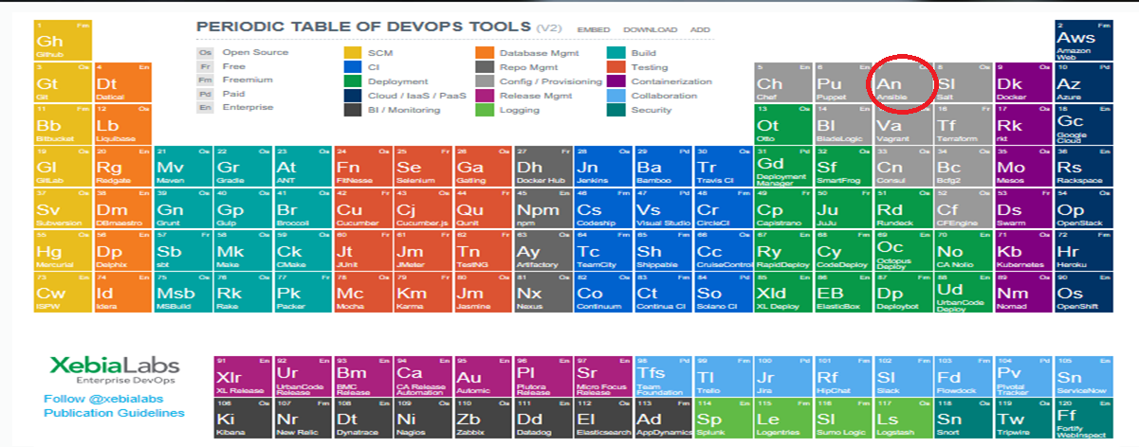
Ansible in XebiaLabs

Slide 8
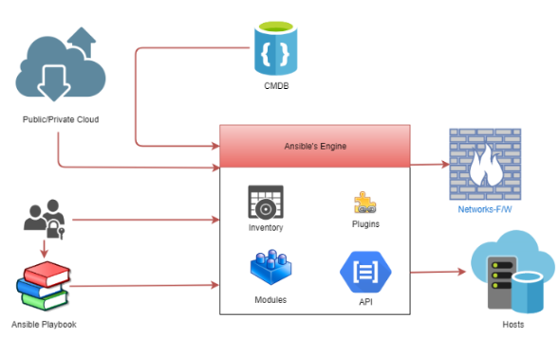
Ansible Architecture

Slide 9

Ansible control Server and Inside
Module
S
S H
P
Y
T
H
O
N
SSH
Playbook
Ansible Config
Inventory

Slide 10
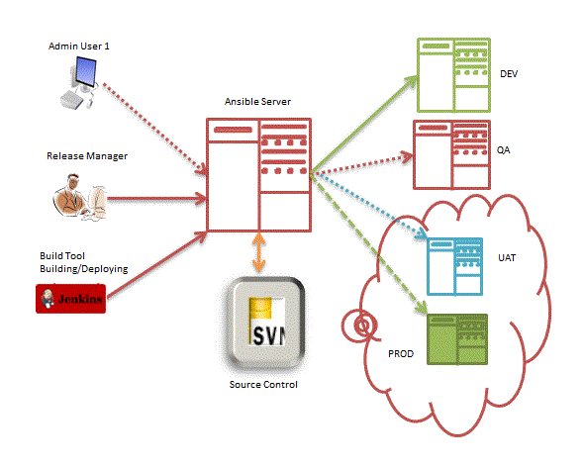
Ansible Architecture Envs
SSH

Slide 11
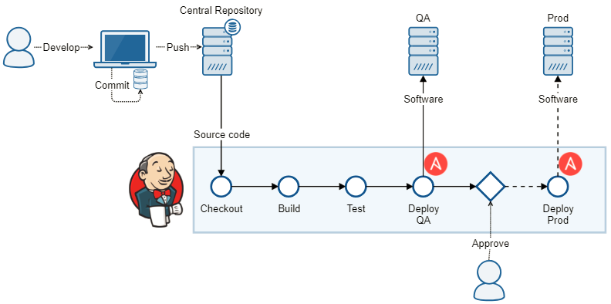
Ansible in Configuration/Deployment

Slide 12
Ansible Standards and Best Practices
Break long lines using YAML line continuation
Try to avoid lines longer than 120 characters in length
Break after a comma (line continuation)
Align the new line with the beginning of the expression
Two spaces should be used as the unit of indentation
Incorrect Usage
- file: dest="{{ test }}" src="/opt/file_transfers/20160830/file1.txt" mode=0600 state=present user="root" group="wheel"
Correct Usage
- file:
dest: "{{ test }}"
src: "/opt/file_transfers/20160830/file1.txt"
mode: 0600
state: present
user: "root"
group: "wheel"

Slide 13
Ansible playbook
site.yml #This is the playbook file
---
- hosts: web-servers
remote_user: root
sudo: yes
roles:
- zip
- tar
- git

Slide 14
Verifying the Installation
After installation just type:
ansible --version
ansible x.x.x

Slide 15
Verifying the Installation
After installation just type:
[ansible@nameofhost ~]$ ansible
Usage: ansible [options]
Options:
-a MODULE_ARGS, --args=MODULE_ARGS
module arguments
-k, --ask-pass ask for SSH password
--ask-su-pass ask for su password
-K, --ask-sudo-pass ask for sudo password
--ask-vault-pass ask for vault password
-B SECONDS, --background=SECONDS
run asynchronously, failing after X seconds
(default=N/A)
………………………………………….

Slide 16
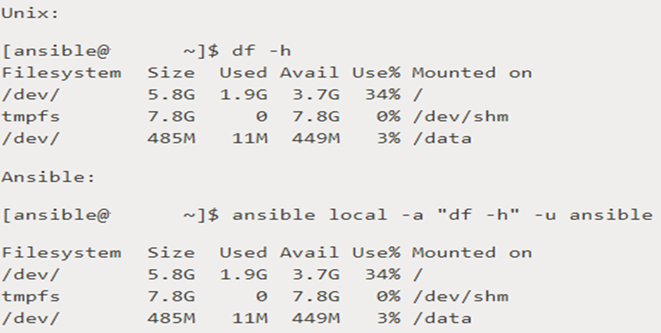
Ansible Ad hock command

Slide 17



Vagrant + VirtualBox + Ansible Arch.
Windows 10 PC

Slide 18

Vagrant + VirtualBox + CnetOS7
Windows 10 PC
ansiblecontrolserver
192.168.10.5
s
s
h
ssh
webserver01
192.168.10.6

Slide 19
Ansible Boto Dyn Inv
Notes:
sudo su
pip install ansible
ansible --version
mkdir ansible
cd ansible/
wget https://raw.githubusercontent.com/ansible/ansible/devel/contrib/inventory/ec2.py
wget https://raw.githubusercontent.com/ansible/ansible/devel/contrib/inventory/ec2.ini
vi ec2.py
export EC2_INI_PATH=./ec2.ini
chmod +x ec2.py
#place your key and value in it
export AWS_ACCESS_KEY_ID='access-key'
export AWS_SECRET_ACCESS_KEY='secret-access-key'
./ec2.py --list
vi site.yml
---
- name: Create a new Demo EC2 instance
hosts: localhost
gather_facts: False
vars:
region: us-east-1
instance_type: t2.micro
ami: ami-14c5486b
keypair: MyKey # pem file name
tasks:
- name: Create an ec2 instance
ec2:
key_name: "{{ keypair }}"
group_id: "sg-69337e21" # security group name
instance_type: "{{ instance_type}}"
image: "{{ ami }}"
region: "{{ region }}"
wait: true
count: 1 # default
count_tag:
Name: Ansible
instance_tags:
Name: Ansible
vpc_subnet_id: subnet-3525e77e
assign_public_ip: yes
register: ec2
.
├── ec2.ini
├── ec2.py
└── site.yml
ansible-playbook -i ec2.py site.yml -vvv

Slide 20
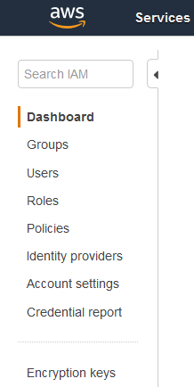
AWS, region & Az’s
Notes:
IAM
Access key
Secret key

Slide 21
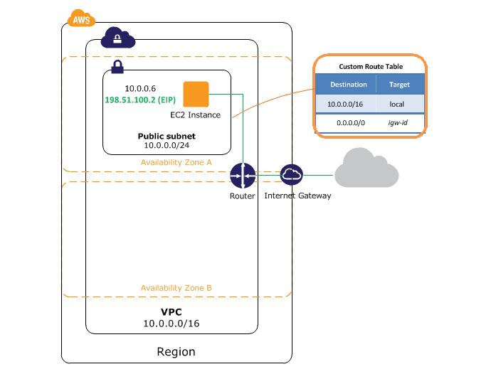
AWS, AWS VPC
Notes:
VPC

Slide 22
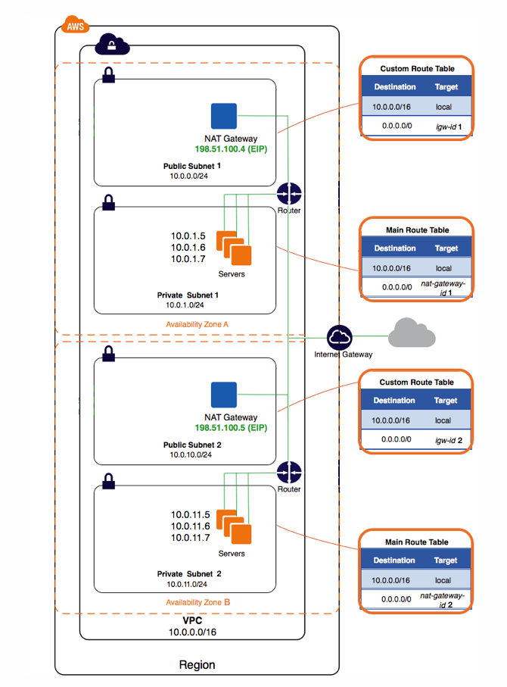
AWS, VPC with HA
Notes:
VPC
With high avaibility

Slide 23
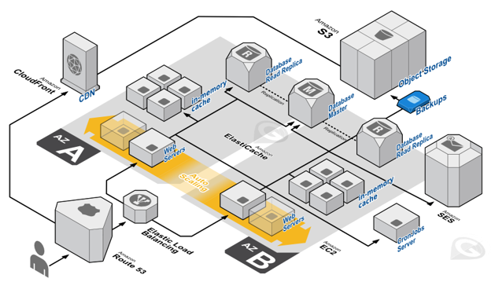
AWS AZ’s

Slide 24
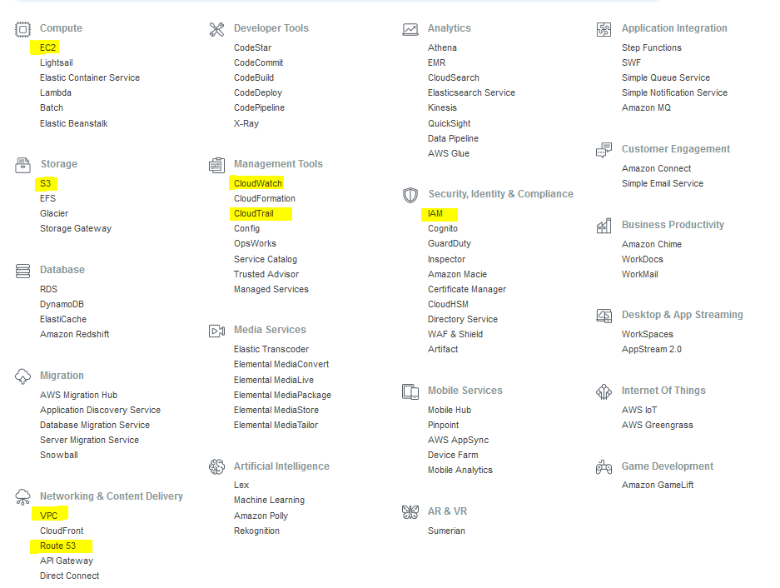
AWS Services

Slide 25
